Slide 1
Software Engineering (CS226) Week 3
Agile, XP and Scrum

Slide 2
Topics covered
Agile methods
Agile development techniques
Agile project management

Slide 3
Agile development
Program specification, design and implementation are inter-leaved
The system is developed as a series of versions or increments with stakeholders involved in version specification and evaluation
Frequent delivery of new versions for evaluation
Extensive tool support (e.g. automated testing tools) used to support development.
Minimal documentation – focus on working code

Slide 4
Agile Manifesto – Core Values
Individuals and interactions over processes and tools
Working software over comprehensive documentation
Customer collaboration over contract negotiation
Responding to change over following a plan
(That is, while there is value in the items on the right, we value the items on the left more.)

Slide 5
Agile Manifesto – 12 Principles
The agile manifesto also identifies 12 principles:
Customer satisfaction by early and continuous delivery of valuable software.
Welcome changing requirements, even in late development.
Deliver working software frequently (weeks rather than months).
Close, daily cooperation between business people and developers.
Projects are built around motivated individuals, who should be trusted.

Slide 6
Agile Manifesto – 12 Principles
Face-to-face conversation is the best form of communication (co-location).
Working software is the primary measure of progress.
Sustainable development, able to maintain a constant pace.
Continuous attention to technical excellence and good design.
Simplicity - the art of maximizing the amount of work not done - is essential.
Best architectures, requirements, and designs emerge from self-organizing teams.
Regularly, the team reflects on how to become more effective, and adjusts accordingly.

Slide 7
Agile principles and organizational practice
Principle | Practice
Customer involvement | This depends on having a customer who is willing and able to spend time with the development team and who can represent all system stakeholders. Often, customer representatives have other demands on their time and cannot play a full part in the software development. Where there are external stakeholders, such as regulators, it is difficult to represent their views to the agile team.
Embrace change | Prioritizing changes can be extremely difficult, especially in systems for which there are many stakeholders. Typically, each stakeholder gives different priorities to different changes.
Incremental delivery | Rapid iterations and short-term planning for development does not always fit in with the longer-term planning cycles of business planning and marketing. Marketing managers may need to know what product features several months in advance to prepare an effective marketing campaign.

Slide 8
Agile principles and organizational practice
Principle | Practice
Maintain simplicity | Under pressure from delivery schedules, team members may not have time to carry out desirable system simplifications.
People not process | Individual team members may not have suitable personalities for the intense involvement that is typical of agile methods, and therefore may not interact well with other team members.

Slide 9
Agile method applicability
Product development where a software company is developing a small or medium-sized product for sale.
Virtually all software products and apps are now developed using an agile approach
Custom system development within an organization, where there is a clear commitment from the customer to become involved in the development process and where there are few external rules and regulations that affect the software.

Slide 10
Agile Development Practices

Slide 11
Extreme programming
A very influential agile method, developed in the late 1990s, that introduced a range of agile development techniques.
Extreme Programming (XP) takes an ‘extreme’ approach to iterative development.
New versions may be built several times per day;
Increments are delivered to customers every 2 weeks;
All tests must be run for every build and the build is only accepted if tests run successfully.

Slide 12
Influential XP practices
Extreme programming has a technical focus and is not easy to integrate with management practice in most organizations.
Consequently, while agile development uses practices from XP, the method as originally defined is not widely used.
Key practices
User stories for specification
Refactoring
Test-first development
Pair programming

Slide 13
User stories for requirements
In XP, a customer or user is part of the XP team and is responsible for making decisions on requirements.
User requirements are expressed as user stories or scenarios.
These are written on cards and the development team break them down into implementation tasks. These tasks are the basis of schedule and cost estimates.
The customer chooses the stories for inclusion in the next release based on their priorities and the schedule estimates.

Slide 14
A ‘prescribing medication’ story

Slide 15
Examples of task cards for prescribing medication

Slide 16
Refactoring
Programming team look for possible software improvements and make these improvements even where there is no immediate need for them.
This improves the understandability of the software and so reduces the need for documentation.
Changes are easier to make because the code is well-structured and clear.
However, some changes requires architecture refactoring and this is much more expensive.

Slide 17
Examples of refactoring
Re-organization of a class hierarchy to remove duplicate code.
Tidying up and renaming attributes and methods to make them easier to understand.
The replacement of inline code with calls to methods that have been included in a program library.

Slide 18
Test-first development
Testing is central to XP and XP has developed an approach where the program is tested after every change has been made.
XP testing features:
Test-first development.
Incremental test development from scenarios.
User involvement in test development and validation.
Automated test harnesses are used to run all component tests each time that a new release is built.

Slide 19
Test-driven development
Writing tests before code clarifies the requirements to be implemented.
Tests are written as programs rather than data so that they can be executed automatically. The test includes a check that it has executed correctly.
Usually relies on a testing framework such as Junit.
All previous and new tests are run automatically when new functionality is added, thus checking that the new functionality has not introduced errors.

Slide 20
Customer involvement
The role of the customer in the testing process is to help develop acceptance tests for the stories that are to be implemented in the next release of the system.
The customer who is part of the team writes tests as development proceeds. All new code is therefore validated to ensure that it is what the customer needs.
However, people adopting the customer role have limited time available and so cannot work full-time with the development team. They may feel that providing the requirements was enough of a contribution and so may be reluctant to get involved in the testing process.

Slide 21
Test case description for dose checking

Slide 22
Test automation
Test automation means that tests are written as executable components before the task is implemented
These testing components should be stand-alone, should simulate the submission of input to be tested and should check that the result meets the output specification. An automated test framework (e.g. Junit) is a system that makes it easy to write executable tests and submit a set of tests for execution.
As testing is automated, there is always a set of tests that can be quickly and easily executed
Whenever any functionality is added to the system, the tests can be run and problems that the new code has introduced can be caught immediately.

Slide 23
Problems with test-first development
Programmers prefer programming to testing and sometimes they take short cuts when writing tests. For example, they may write incomplete tests that do not check for all possible exceptions that may occur.
Some tests can be very difficult to write incrementally. For example, in a complex user interface, it is often difficult to write unit tests for the code that implements the ‘display logic’ and workflow between screens.
It difficult to judge the completeness of a set of tests. Although you may have a lot of system tests, your test set may not provide complete coverage.

Slide 24
Pair programming
Pair programming involves programmers working in pairs, developing code together.
This helps develop common ownership of code and spreads knowledge across the team.
It serves as an informal review process as each line of code is looked at by more than 1 person.
It encourages refactoring as the whole team can benefit from improving the system code.

Slide 25
Pair programming
In pair programming, programmers sit together at the same computer to develop the software.
Pairs are created dynamically so that all team members work with each other during the development process.
The sharing of knowledge that happens during pair programming is very important as it reduces the overall risks to a project when team members leave.
Pair programming is not necessarily inefficient and there is some evidence that suggests that a pair working together is more efficient than 2 programmers working separately.

Slide 26
Agile Project Management

Slide 27
Agile project management
The principal responsibility of software project managers is to manage the project so that the software is delivered on time and within the planned budget for the project.
The standard approach to project management is plan-driven. Managers draw up a plan for the project showing what should be delivered, when it should be delivered and who will work on the development of the project deliverables.
Agile project management requires a different approach, which is adapted to incremental development and the practices used in agile methods.

Slide 28
Scrum
Scrum is an agile method that focuses on managing iterative development rather than specific agile practices.
There are three phases in Scrum.
The initial phase is an outline planning phase where you establish the general objectives for the project and design the software architecture.
This is followed by a series of sprint cycles, where each cycle develops an increment of the system.
The project closure phase wraps up the project, completes required documentation such as system help frames and user manuals and assesses the lessons learned from the project.

Slide 29
Scrum benefits

Slide 30
Scrum terminology (a)
Scrum term | Definition
Development team | A self-organizing group of software developers, which should be no more than 7 people. They are responsible for developing the software and other essential project documents.
Potentially shippable product increment | The software increment that is delivered from a sprint. The idea is that this should be ‘potentially shippable’ which means that it is in a finished state and no further work, such as testing, is needed to incorporate it into the final product. In practice, this is not always achievable.
Product backlog | This is a list of ‘to do’ items which the Scrum team must tackle. They may be feature definitions for the software, software requirements, user stories or descriptions of supplementary tasks that are needed, such as architecture definition or user documentation.
Product owner | An individual (or possibly a small group) whose job is to identify product features or requirements, prioritize these for development and continuously review the product backlog to ensure that the project continues to meet critical business needs. The Product Owner can be a customer but might also be a product manager in a software company or other stakeholder representative.

Slide 31
Scrum terminology (b)
Scrum term | Definition
Scrum | A daily meeting of the Scrum team that reviews progress and prioritizes work to be done that day. Ideally, this should be a short face-to-face meeting that includes the whole team.
ScrumMaster | The ScrumMaster is responsible for ensuring that the Scrum process is followed and guides the team in the effective use of Scrum. He or she is responsible for interfacing with the rest of the company and for ensuring that the Scrum team is not diverted by outside interference. The Scrum developers are adamant that the ScrumMaster should not be thought of as a project manager. Others, however, may not always find it easy to see the difference.
Sprint | A development iteration. Sprints are usually 2-4 weeks long.
Velocity | An estimate of how much product backlog effort that a team can cover in a single sprint. Understanding a team’s velocity helps them estimate what can be covered in a sprint and provides a basis for measuring improving performance.

Slide 32
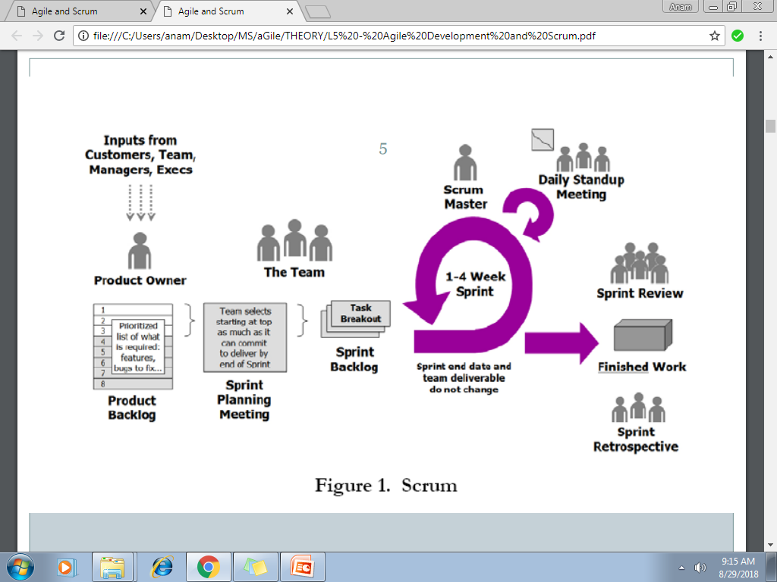
The Scrum Process

Slide 33
The Scrum Sprint Cycle
Sprints are fixed length, normally 2–4 weeks.
The starting point for planning is the product backlog, which is the list of work to be done on the project.
The selection phase involves all of the project team who work with the customer to select the features and functionality from the product backlog to be developed during the sprint.

Slide 34
The Scrum Sprint Cycle
Once these are agreed, the team organize themselves to develop the software.
During this stage the team is isolated from the customer and the organization, with all communications channelled through the so-called ‘Scrum master’.
The role of the Scrum master is to protect the development team from external distractions.
At the end of the sprint, the work done is reviewed and presented to stakeholders. The next sprint cycle then begins.

Slide 35
Scrum Roles
In Scrum, there are three primary roles:
1. The Product Owner
2. Team Members
3. The ScrumMaster

Slide 36
Product Owner
The Product Owner is responsible for taking all the inputs into what the product should be – from the customer or end-user of the product, as well as from Team Members and stakeholders – and translating them into a product vision.
In some cases, the Product Owner and the customer are one and the same.
Product owner is responsible for product backlog, manages release plan, adjusts priorities based on ROI and business value, accepts or rejects work results.

Slide 37
Team Members
Team Members build the product that the customer is going to consume: the software, the website, or whatever it may be.
The team in Scrum is typically five to ten people, although teams as large as 15 and as small as 3 commonly report benefits.
The team should include all the expertise necessary to deliver the finished work – so, for example, the team for a software project might include roles ( programmers, interface designers, testers, marketers, and researchers).

Slide 38
Scrum Master
The Scrum Master is tasked with doing whatever is necessary to help the team be successful.
The Scrum Master is not the manager of the team; he or she serves the team, by helping remove blocks to the team’s success, facilitating meetings, and supporting the practice of Scrum.
Some teams will have someone dedicated fully to the role of Scrum Master, while others will have a team member play this role (carrying a lighter load of regular work when they do so).

Slide 39
Scrum Master
Great Scrum Masters have come from all backgrounds and disciplines: Project Management, Engineering, Design, Testing.
The Scrum Master and the Product Owner probably shouldn’t be the same individual; at times, the Scrum Master may be called upon to push back on the Product Owner (for example, if they try to introduce new requirements in the middle of a Sprint).

Slide 40
Product Backlog
The product backlog is a list of what needs to be done to complete the development of the product.
The items on this list are called product backlog items (PBIs).
The product backlog may include a variety of different items such as product features to be implemented, user requests, essential development activities and desirable engineering improvements.
The product backlog should always be prioritized so that the items that be implemented first are at the top of the list.

Slide 41
Product Backlogs Entries (Examples)
As a teacher, I want to be able to configure the group of tools that are available to individual classes. (feature)
As a parent, I want to be able to view my childrens’ work and the assessments made by their teachers. (feature)
Establish criteria for the assessment of open source software that might be used as a basis for parts of this system. (development activity)
Refactor user interface code to improve understandability and performance. (engineering improvement)
Implement encryption for all personal user data. (engineering improvement)

Slide 42
Product Backlog Item States (Typical)
Ready for consideration These are high-level ideas and feature descriptions that will be considered for inclusion in the product. They are tentative so may radically change or may not be included in the final product.
Ready for refinement The team has agreed that this is an important item that should be implemented as part of the current development. There is a reasonably clear definition of what is required. However, work is needed to understand and refine the item.
Ready for implementation The PBI has enough detail for the team to estimate the effort involved and to implement the item. Dependencies on other items have been identified.

Slide 43
Product Backlog Activities

Slide 44
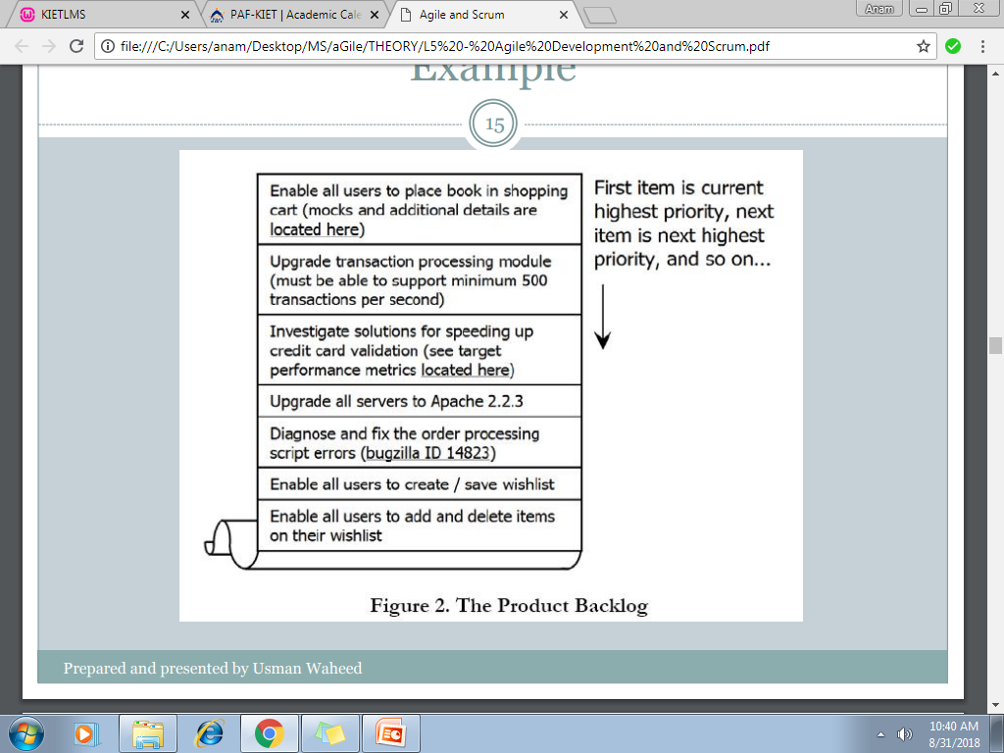
Product Backlog (Example)

Slide 45
Sprint Planning Meeting
In the first part of the Sprint Planning Meeting, the Product Owner and Scrum Team (with facilitation from the Scrum Master) review the Product Backlog, discussing the goals and context for the items on the Backlog, and providing the Scrum Team with insight into the Product Owner’s thinking.
In the second part of the meeting, the Scrum Team selects the items from the Product Backlog to commit to complete by the end of the Sprint, starting at the top of the Product Backlog (in others words, starting with the items that are the highest priority for the Product Owner) and working down the list in order.
;

Slide 46
Sprint Planning Meeting
This is one of the key practices in Scrum: the team decides how much work they will commit to complete, rather than having it assigned to them by the Product Owner. This makes for a much more reliable commitment
The Sprint Planning meeting will often last a number of hours
the team is making a very serious commitment to complete the work, and this commitment requires careful thought to be successful.

Slide 47
Sprint Planning Meeting
The team will begin by estimating how much time each member has for Sprint-related work – in other words, their average workday minus the time they spend doing things like critical bug-fixes and other maintenance, attending meetings, doing email, taking lunch breaks, and so on. For most people this works out to 4-6 hours of time per day available for Sprint-related work. (Figure 3.)

Slide 48
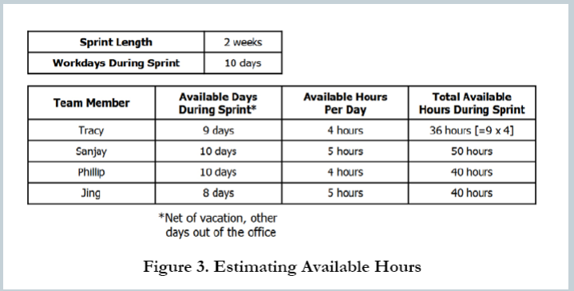
Sprint Planning Meeting

Slide 49
Sprint backlog
Once the time available is determined, the team starts with the first item on the Product Backlog
In other words, the Product Owner’s highest priority item – and working together, breaks it down into individual tasks, which are recorded in a document called the Sprint Backlog (Figure 4).
At the end of the meeting, the team will have produced a list of all the tasks, and for each task who has signed up to complete it and how much time they estimate it will take (typically in hours or fractions of a day).

Slide 50
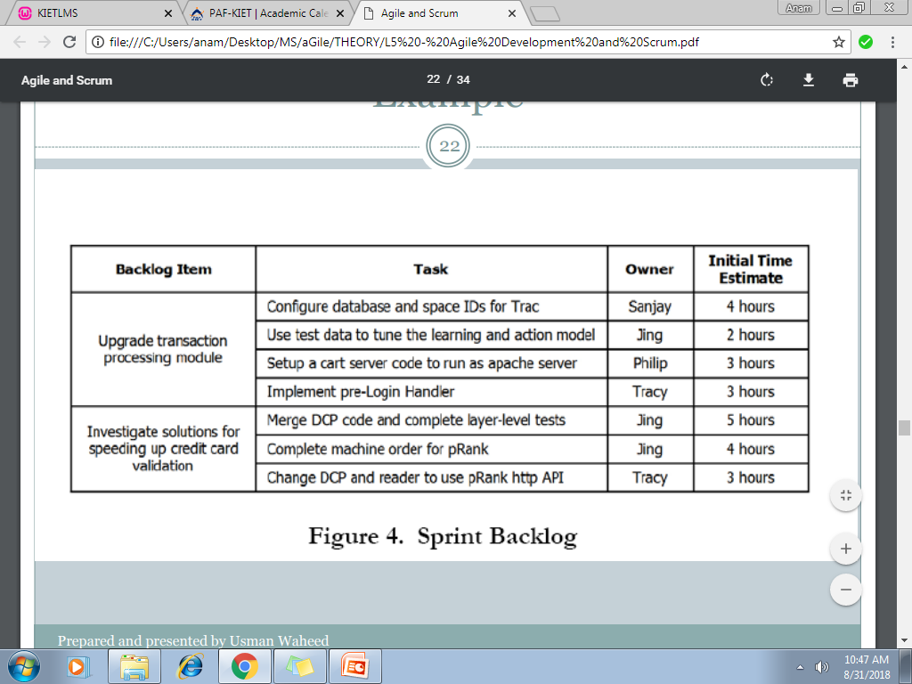
Sprint backlog

Slide 51
Scrum Change
One of the key pillars of Scrum is that once the Scrum Team makes its commitment, the Product Owner cannot add new requests during the course of the Sprint.
This means that even if halfway through the Sprint the Product Owner decides that they want to add something new, he or she cannot make changes until the start of the next Sprint.
If an external circumstance appears that significantly changes priorities, and means the team would be wasting its time if it continued working, the Product Owner can terminate the Sprint.
This means the team stops all the work they are doing, and starts over with a Sprint Planning meeting, and so forth.

Slide 52
Daily Standup Meeting
Once the Sprint has started, the Scrum Team engages in another of the key Scrum practices: The Daily Stand-Up Meeting.
This is a short (15 minute) meeting that happens every workday at an appointed time, and everyone on the Scrum Team attends; in order to ensure it stays brief, everyone stands (hence “Stand-Up Meeting”).
It’s the team’s opportunity to report to itself on progress and obstacles.

Slide 53
Daily Standup Meeting
One by one, each member of the team reports just three things to the other members of the team:
What they were able to get done since the last meeting.
What they’re aiming to get done by the next meeting.
Any blocks or obstacles that are in their way.
There’s no discussion during the Daily Stand-Up Meeting, just the reporting of the three key pieces of information; if discussion is required, it takes place right after the meeting.
The Scrum Master makes note of the blocks, and then helps team members to resolve them after the meeting.

Slide 54
Sprint status
One of the core tenets of Scrum is that the duration of the Sprint is never extended – it ends on the assigned date regardless of whether the team has completed the work it committed to or not.
If the team has not completed their Sprint Goal, the remaining tasks are re-prioritized and the issue is brought up the sprint review and retrospective meeting .

Slide 55
Sprint Review
At the end of each sprint, there is a review meeting, which involves the whole team. This meeting:
reviews whether or not the sprint has met its goal.
sets out any new problems and issues that have emerged during the sprint.
is a way for a team to reflect on how they can improve the way they work.
The product owner has the ultimate authority to decide whether or not the goal of the print has been achieved. They should confirm that the implementation of the selected product backlog items is complete.

Slide 56
Sprint Review
The sprint review should include a process review, in which the team reflects on its own way of working and how Scrum has been used.
The aim is to identify ways to improve and to discuss how to use Scrum more productively.

Slide 57
Sprint Retrospective
Following the Sprint Review, the team gets together for the Sprint Retrospective.
The focus of this meeting is process improvement rather than productivity improvement.
It’s an opportunity for the team to discuss what’s working and what’s not working, and agree on changes to try.
Three questions are asked off each participant:
What went well for you in this sprint?
What went bad?
What can be improved?

Slide 58
Starting the Next Sprint
Following the Sprint Review Meeting, the Product Owner takes all the input, as well as all new priorities that have appeared during the Sprint, and incorporates them into the Product Backlog; new items are added, and existing ones are modified, reordered, or deleted.
Once this updating of the Product Backlog is complete, the cycle is ready to begin all over again, with the next Sprint Planning Meeting.
One practice many teams find useful is to hold a Prioritization Meeting toward the end of each Sprint, to review the Product Backlog for the upcoming Sprint with the Product Owner.

